Slide 1

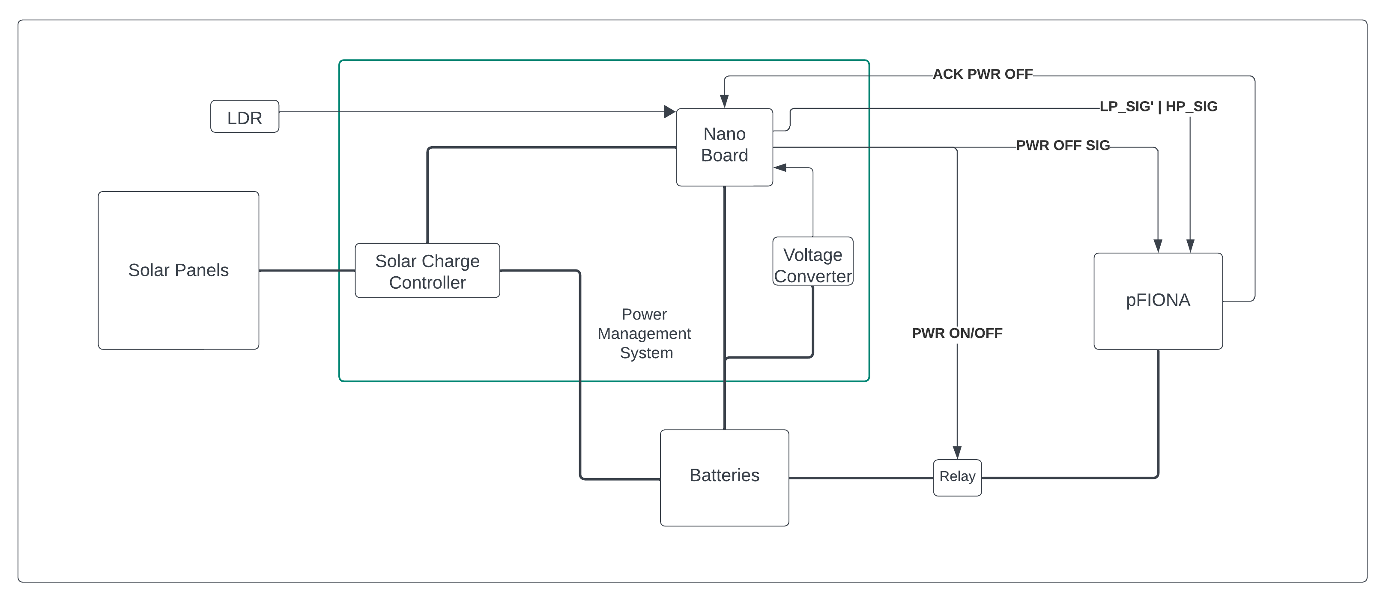
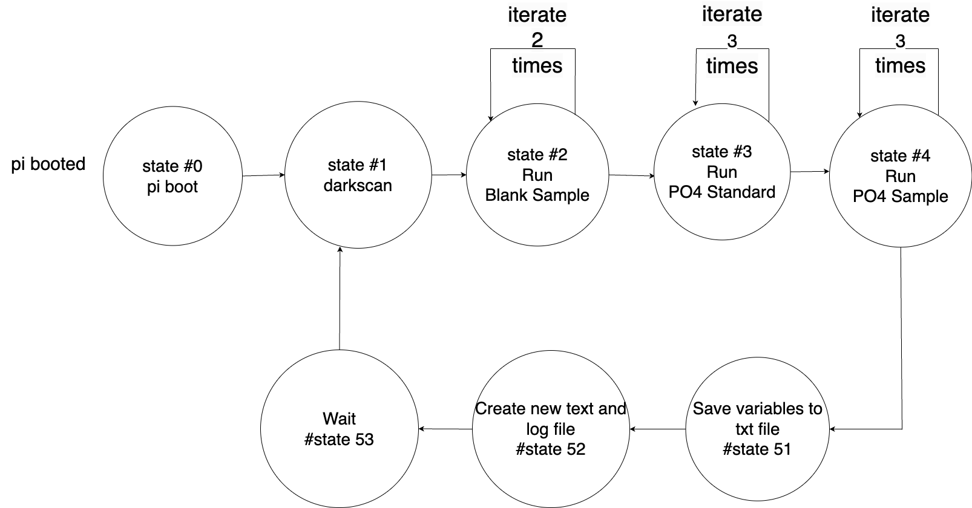
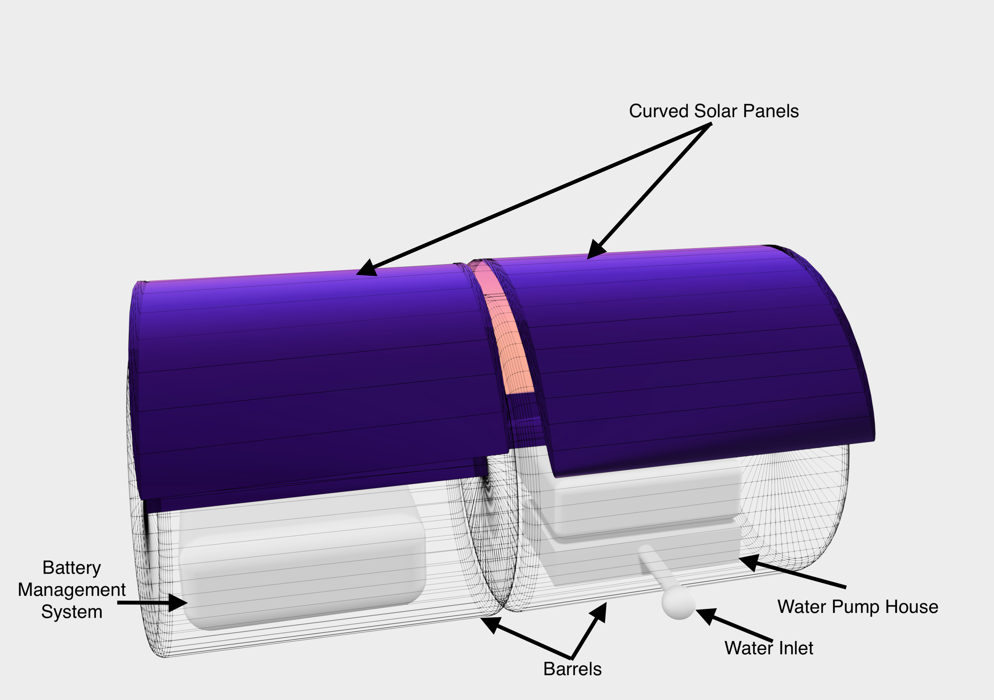
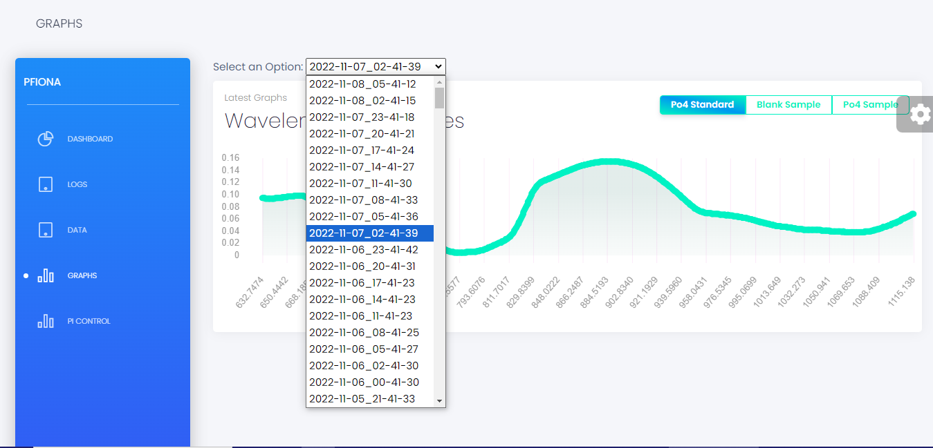
Computer Engineering Department
Implementing an Intermittent Computing System for an Autonomous Ocean Analyzer Prototype
Project Advisor: Dr. Haonan Wang
Bhanderi, Virag (MS Software Engineering) Dudhatra, Milan (MS Software Engineering)
Patel, Moxank (MS Computer Engineering)
Introduction
Solar charge controllers: Used to manage battery charging for solar panels. Maximum Power Point Tracking (MPPT) type controllers can provide high charging efficiency with high power systems and Pulse Width Modulation (PWM) type controllers are more suitable for low power systems.
Figure 2 depicts the buoy design that houses the power management system, the analyzer, and the water collection and disposal system. We use a cylinder shaped design that has high structural strength. This design can also provide a roly-poly effect to improve the buoy’s steadiness in the water and ensure that the solar panel always faces upward. Within the housing, we use modular design to provide isolation between systems. The gap between the modular is also filled with foam to further enhance the resistance to water, impact, heat, and electric shock.
Real-time monitoring of the complex dynamics of nutrients in the ocean can greatly improve our understanding of the marine ecosystems. This can be achieved through a system that can be deployed directly in the ocean with high reliability, sustainability, and accuracy in analysis. In this work, we design and develop a integrated system for the Programmable Flow Injection Ocean Nutrient Analyzer (pFIONA), the state-of-the-art seawater analyzer, making it reliable, self-sustainable, and easy-to-use when deployed in the sea. Our main contributions are as follows.
Solar-Powered Buoy Design: We design an encapsulation that carries solar panels on its exterior. Its interior contains modules for power management, seawater collection and disposal, and the analyzer. This design aims to protect the system from the harsh environment in the sea.
Power Management System: We design a system to maximize the sustainability of the analyzer by a) Optimizing the energy harvesting efficiency from solar panels, b) Dynamically scheduling the execution cycles of the analyzer, and c) Incorporate Dynamic Voltage and Frequency Scaling (DVFS) to reduce power usage of the controller board.
Intermittent Computing Framework: Due to the Intermittent nature of energy harvesting, we provide high reliability to the system by employing a state machine structured framework and a coarse-grained checkpointing approach in our implementation.
Upgraded User Interface: Based on the original UI for pFIONA, we developed a web-based UI using Django framework. This new UI design provides additional controls for power management, more options and tools, better visual and layout design, and better accessibility.
It can connect multiple analyzer and switch between them. The UI consists of various tabs and plentiful functionalities within each tab. For example, dashboard tab shows an overview of pFIONA’s status and most commonly used controls; Log tab shows detailed logs for control, and debugging. Data tab shows history of data collected from the analyzer. Graphs tabs (Figure 4) provides various visualizations of the collected data. Control tab contains a set of buttons and input boxes to provide detailed control of the analyzer’s status and adjust its working parameters.
Design and Implementation
Summary
This work implements an intermittent computing system for the ocean analyzer pFIONA. We deliver a complete analyzer package through our carefully designed buoy, power management system, intermittent computing framework, and user interface. Our system can provide high reliability and sustainability in complex marine environments. Our upgraded web-based UI also improves accessibility and ease-of-use. These advancements collectively make pFIONA a more practical and effective tool for real-time ocean nutrient monitoring.
Figure 1. Power Management System Design
Figure 1 illustrates the system architecture of the power management system. It meticulously monitors battery charge levels and weather conditions and make intelligent scheduling choices according to a decision tree model. The key component of the system as follows:
Solar Panel: Used for energy harvesting, ensuring system’s energy autonomy.
Solar Charge Controllers: Regulate the charge voltage to the battery to maximize the charge efficiency and prolong battery life.
LDR Sensor: Incorporated to measure ambient light intensity, thereby adjusting the charging cycle and operation cycles of the analyzer.
Nano Board: Make intelligent scheduling decisions based weather conditions and history data. It is also used to measure parameters like battery charge level and charging rate.
Figure 3. High Level State Diagram of the Analyzer
Key References
We use Raspberry PI as the control of the analyzer. To ensure the reliability of the system, we design a coarse-grained intermittent computing framework that divides all our working procedures into independent states. Figure 3 shows a high level state diagram of the analyzer. This way, we can create a checkpoint for each state so that in the event of power disruption, the system can resume operations from the last finished state without data corruption. Since many analyzer related tasks cannot be interrupted and to make sure the system can make progress, the power management system will not allow any state to start until the battery reaches a minimum charge threshold.
[1]. M. Lebrec et al., "Developing Autonomous, Open-Source Macronutrient Monitoring Instrumentation: The Programmable Flow Injection Ocean Nutrient Analyzer (pFIONA)," in AGU Fall Meeting Abstracts, vol. 2022, 2022.
[2]. M. Hatta, et al., "An advanced method for the determination of iron (III) and iron (II) in seawater by catalytic spectrophotometric flow injection analysis," Limnol. Oceanogr.: Methods, vol. 19, no. 2, pp. 74-88, 2021.
[3]. V. Hanumaiah and S. Vrudhula, "Energy efficient operation of multicore processors by DVFS, task migration, and active cooling," in IEEE Transactions on Computers, vol. 63, no. 3, pp. 349-360, March 2014.
[4]. J. Kwak, et al., "ICEr: An Intermittent Computing Environment Based on a Runtime Module for Energy-Harvesting IoT Devices with NVRAM," Electronics, vol. 10, no. 8, p. 879, 2021.
Background
Programmable Flow Injection Ocean Nutrient Analyzer (pFIONA): It is the state-of-the-art ocean nutrient analyzer that automatically analyzes chemicals in seawater using spectrophotometer [1,2].
Power Management System: A system used to manage the energy harvesting and storage and schedule the device execution to maximize the system’s sustainability and availability.
Dynamic Voltage Frequency Scaling (DVFS): A power-saving technique that makes tradeoff between power reduction and performance of electronic systems by adjusting their clock frequency [3].
Intermittent Computing: Used by systems with non-continuous energy sources. Checkpointing techniques are essential to such systems in order to make progress during intermittent power supply [4].
Acknowledgement
Figure 4. User Interface Example: Graph Logs
We are profoundly thankful for the invaluable support and guidance provided by Dr. Haonan Wang, Dr. Maxime, and the entire team at MLML. Their contributions have been essential to the advancement of our work.
Figure 2. Buoy Design
Our new UI uses the Django REST framework to provide a web-based design. The UI runs on the host (e.g., PC) and communicates with the analyzer’s controller through WiFi.

